Slide 1

Simple Calculator: HTML, CSS, and JavaScript
This project explores the development of a basic calculator application using the core web technologies of HTML, CSS, and JavaScript. The goal is to create a clean, intuitive interface that can perform common arithmetic operations with ease.

Slide 2

Project Objective
Functional Calculator
Intuitive Design
Develop a calculator that can handle addition, subtraction, multiplication, and division operations.
Create a user-friendly interface that is easy to navigate and understand.
Cross-Platform Compatibility
Responsive Development
Ensure the calculator works seamlessly across various devices and screen sizes.
Leverage responsive design principles to optimize the UI for different viewport sizes.

Slide 3
User Interface Design
Layout
Buttons
Display
The calculator will have a grid-based layout, with buttons arranged in a familiar 3x4 configuration.
The buttons will include numeric keys (0-9), basic arithmetic operations (+, -, *, /), and control keys (AC, =).
A clear, readable display will show the current calculation and result, using a modern, clean font.

Slide 4

Key Features
1
Arithmetic Operations
2
Clear Display
A large, easy-to-read display will show the current calculation and the result.
The calculator will support the four basic arithmetic operations: addition, subtraction, multiplication, and division.
3
Keyboard Support
4
Responsive Design
Users will be able to use their computer keyboard to interact with the calculator.
The calculator will adapt to different screen sizes, ensuring a consistent user experience across devices.

Slide 5

Implementing Calculations
1
Input Handling
Capture user input from the buttons or keyboard, and update the display accordingly.
2
Arithmetic Logic
Implement the core logic to perform addition, subtraction, multiplication, and division operations.
3
Result Display
Update the display with the calculated result, ensuring proper formatting and decimal handling.

Slide 6

Handling Edge Cases
Division by Zero
Overflow
Detect and handle attempts to divide by zero, displaying an appropriate error message.
Ensure the calculator can handle large numbers without causing an overflow or display issues.
Decimal Precision
Input Validation
Implement rounding and precision control to display results with the desired number of decimal places.
Validate user inputs to prevent invalid characters or operations from being performed.

Slide 7
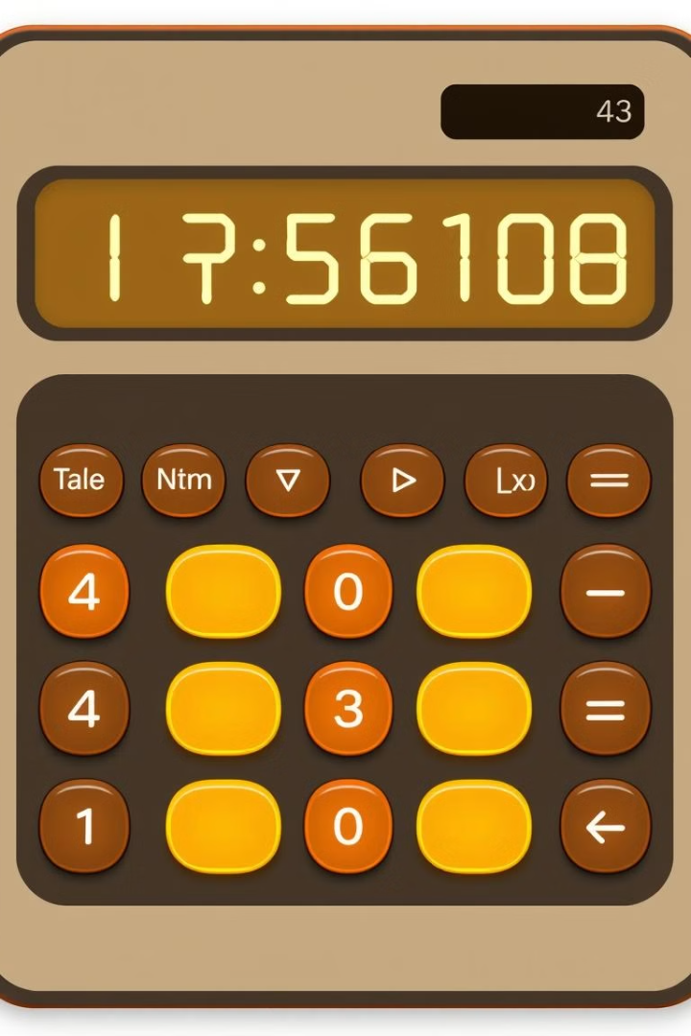



Styling and Animations
Button Styles
Create visually appealing button designs with hover and active states.
Display Animations
Implement subtle animations to enhance the visual feedback during calculations.
Responsive Styling
Ensure the calculator's appearance and layout adapt seamlessly to different screen sizes.

Slide 8
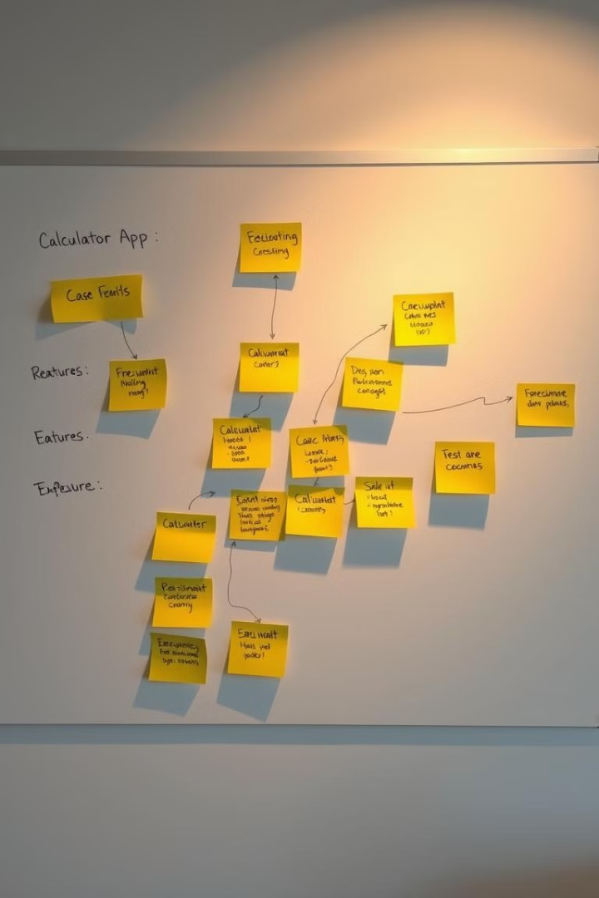



Future Improvements
Advanced Functions
Expand the calculator's capabilities to include more advanced operations, such as scientific functions, percentages, and memory storage.
Theme Customization
Allow users to customize the calculator's appearance, such as color schemes and font styles, to match their personal preferences.
Voice Control
Integrate voice recognition technology to enable hands-free operation of the calculator, improving accessibility and convenience.

